Slide 1
Principles of Communication © Wisconsin Organization of Nurse Executives

Slide 2
Communication… Just because you’re talking doesn’t mean you are communicating
Notes:
Good morning…
Give brief intro
As a leader, having great communication skills is essential.
Haven’t we all experience this….think about some of the interactions you have had with patients-we think we are communicating and when we validate …it is not at all what we said….
As you are going to hear…..in leadership the same barriers and miscommunications can exist.

Slide 3
Objectives
List two barriers to effective communication
List two methods to assure effective communication has occurred
Recognize the significant value that mastering the skill of communication will make in your growth as a leader
Notes:
Two barriers…..emotional intelligence and trust
Methods to assure effective communication: speaking , listening, writing, and reading
Talk about the Value of being a great communicator: along with a couple cautions on social media, and email

Slide 4
Great leaders move us.
They ignite our passions and inspire the best in us.
Notes:
Engage the audience…….Who are some great leaders of our time???
Great Leaders of our time:
Ronald Reagan
FDR
Billy Graham
Ghandi
JFK
Rudy Guliani
Lee Ioccoca
Peter Senge
Vince Lombardi
What was it about them that made you feel they were great?
Engage the audience…….Who are some great leaders of our time???
Great Leaders of our time:
Ronald Reagan
FDR
Billy Graham
Ghandi
JFK
Rudy Guliani
Lee Ioccoca
Peter Senge
Vince Lombardi
What was it about them that made you feel they were great?

Slide 5
When we try to explain why they are so effective, we speak of strategy, vision or powerful ideas.
…but the reality is much more primal

Slide 6
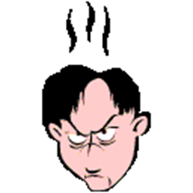
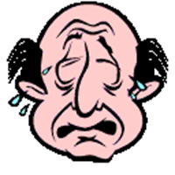
Great leaders work through the emotions!”
- Daniel Goleman, Primal Leadership, The power of emotional intelligence
Notes:
Works through the emotions . . What do you think that means?
Only 36% of people tested can accurately identify their emotions as they happen. That means 2/3 of us are controlled by our emotions and we aren’t as skilled at using them to our benefit. 5 basic emotions: ( Happiness, sadness, anger, fear and shame.)
Leaders are more effective when they are emotionally intelligent.
Site Book – “Emotional Intelligence” by Travis Bradberry & Jean Greaves
Emotional Intelligence 2.0

Slide 7
Emotional Intelligence 2.0
PERSONAL COMPETENCE
SELF AWARENESS
SELF
MANAGEMENT
SOCIAL COMPETENCE
SOCIAL
AWARENESS
RELATIONSHIP
MANAGEMENT
Notes:
Show book: Give examples You have the ability to learn your EQ score…and then create strategies to improve.
Self awareness and Self Management:
Personal competence is related to your self awareness and self management: Do you know your triggers….What triggers an emotional reaction in you….how do you respond? Think of a time at work…or perhaps one of your children says something, or behaves in a way that triggers an emotion in you…anger, defensiveness, frustration….Do you raise your voice, clam up, do you say things out of anger? Are you aware of your own emotions…and then are you able to manage them.
An example: Say you are having to deal with an employee for the 2rd time on the need for them to complete their assignments….Can you feel yourself getting frustrated? Does it come out in your communication?
Social Awareness:
When in a meeting—and you are having to discuss changes that are occurring with a new process…..are you reading the audience? Are folks paying attention? Are they on their cell phones? Doodlers, cell phone users, eye rolling, disengaged, arms and legs crossed……
Do you approach cross team issues with the “seek first to understand” thought?
Men score higher in self-management…and women score higher in social awareness and relationship management.
Baby boomers and Milenials (Gen Y’s) differ most in their self management skills.
(CEO’s and other Senior Execs, on average, have the lowest EQ scores in the workplace.
The link between EQ and “earnings” is so direct, that every point increase in your EQ score—adds about $1300 to an annual salary.

Slide 8
No matter what leaders set out to do –
whether its creating strategy or mobilizing teams
to action – their success depends on “how” they do
it.
Notes:
Dealing with people is messy
So, first, how strong is your Emotional Intelligence – your radar for reading accurately and subsequently managing yourself and others.
Then, what is your relationship with those you are trying to lead?
Table exercise: Discuss your biggest strength and your biggest area of opportunity with your own emotional intelligence. Is it under personal competence or social competence? What makes you think that is the case?

Slide 9
T
R
U
S
T
Credibility + Reliability + Intimacy
=
Self Interest
Notes:
Charles H. Green co-wrote two books: The Trusted Advisor and Trust-Based Selling The Trust Equation
C = Credibility has to do with the words we speak. In a sentence, we might say, "I can trust what she says about intellectual property; she is very credible on the subject. R = Reliability By contrast, reliability has to do with actions. We might say, for example, "If he says he'll deliver the product tomorrow, I trust him, because he's dependable." I = Intimacy Intimacy refers to the safety or security that we feel when entrusting someone with something. We might say, "I can trust her with that information; she's never violated my confidentiality before, and she would never embarrass me." S = Self-interest Self-orientation refers to the focus of the person in question: in particular, whether the person's focus is primarily on himself or herself, or on the other person. Increasing the value of the factors in the numerator increases the value of trust. Increasing the value of the denominator*that is, self-orientation*decreases the value of trust.
10/5 = 2 10 / 2 = 5

Slide 10
Trust Equation
When we think of trust and what it means, we quickly realize it encompasses many things.
We use the word “trust” to:
Interpret what people say
Describe behaviors
Decide if we feel comfortable sharing information
Indicate whether we feel other people have our interests at heart
Notes:
Why is trust so important?
Discuss that this is why employees trust communication from the boss over a remote executive. How much opportunity does a remote exec have to build in particular, Intimacy, in order to have strong Trust?
Trust and integrity as a leader are key attributes that impact your success.
As a leader…..you help create the trust with senior leaders. An example is when “changes are occurring within the system” do you create us versus them

Slide 11
IMPORTANCE OF COMMUNICATION
Human Communication is among the few things absolutely essential to life.
-Yoder-Wise & Kowalski, (2006)
Notes:
The key to effective communication is self-knowledge and sensitivity to others.
Table exercise: What do you find most difficult surrounding communication in your current role? Perhaps your biggest fears or concerns if you are just moving into a leadership role or aspiring to develop into one.

Slide 12
Communication
What we hear is rarely what is meant
What we say is rarely what is heard
And yet… everyone assumes that their communication is effective!
Notes:
Think of the times that someone has really gotten bent out of shape over something…..and really, it wasn’t that one thing that frustrated them, it just happened to be the last thing that set them off.
Get to understand what is really going on with people…..is the one event really the issue…or are there other things.
Share an example of when communication was misunderstood in my role.

Slide 13
Communication
We communicate loudly prior to ever opening our mouths
The three elements in the communication process:
Words that are used 7%
Body language 55%
Tone, pitch and speed of voice 38%
-McClain & Romaine, (2002)
Notes:
We have learned that this is true even when dealing with patients. As leaders, this is no different. We must be aware of the barriers in communication and the route of communication that is most effective for the circumstance and for the receiver. With our patients we use “teach back”. Even as leaders, teach back is an essential tool.

Slide 14
Communication
Your body language is more important than what you say.
Is your body saying “I am here for you and you have my full attention?”
Is your body saying ”You and your issues are not important to me, or at least not as important as the other things I am doing right now.”
Notes:
As a leader, do you make eye contact….are you using your phone while others are talking to you…..Do you have your back to the person that is trying to engage you?
Understand the rules of the culture…..(treat others as to how they want to be treated)

Slide 15
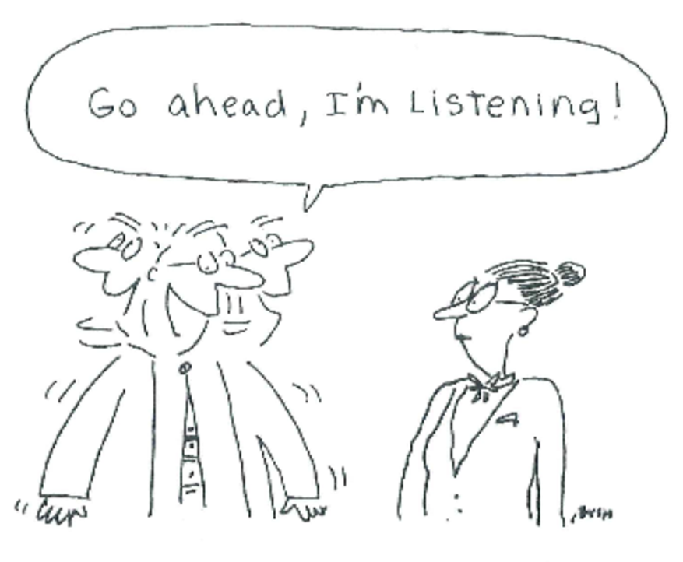

Slide 16
Communication
Effective communication does not occur “naturally”
We assume others know what we mean and that we know what they mean
We stop listening
Effective communication requires feedback - both on the sending and receiving ends
Providing feedback gives the opportunity to assure that communication has been effective
Notes:
Sometimes you need to practice your communication. As a new leader, find a mentor that can guide you. Esp. when you are going into a difficult conversation. I recommend the book: Crucial Conversations: Patterson, K., Grenny, J., McMillan, R., Switzler, A. (2002). Crucial conversations.
New York, NY: McGraw Hill.

Slide 17
Modes of Communication
Speaking/Verbal
Listening
Writing
Reading
Notes:
Practice your skills. Just as you did being a nurse, being a leader requires you to continue to learn and practice!!!
Proof-read or have others read your work if you are preparing a document that is going out to your team/department. Learn how to convey your messages clearly and concisely.
Practice listening. This can be a challenge. Often as a nurse, you wanted to fix or immediately act. Sometimes you have to validate whether someone is talking to you because they want your help, or because they just want you to listen.
On going reading is critical. Often I use my own library of books for those I am mentoring.

Slide 18
Verbal Communication
Verbal communication skills are critical for a leader
Most people don’t have trouble talking
Most communication has little to do with words
-McClain & Romaine (2002)
Notes:
Think about your presence. Do you say “hi” to your team members every day? Do you make eye contact. I often tell folks to use a mirror. How do you look when you are communicating. What is your posture, how do you have your arms. Practicing in the elevator is a great way to learn how to engage someone in a short period of time. Your team wants you to feel comfortable engaging with them. If you are in your office all the time and can’t communicate, the team will not engage or follow you as a leader.

Slide 19
Verbal Communication
Examine your speaking style
Do you overuse jargon?
Is your voice gentle, soft, harsh or intimidating?
Is your style too formal or too casual?
Do you have an accent that makes it difficult for others to understand you?
-Sorensen-Marshall (2011)
Notes:
This is important as you lead meetings or try to influence others. Example: if you are a fast talker….it can be exhausting for those around you. If you know you speak softly, then you need to position yourself well in meetings. If you are too casual, folks may not take you seriously.

Slide 20
EFFECTIVE LISTENING

Slide 21
LISTENING: Four Principles
Listening is a gift. We are often not generous with this gift.
Listening allows speaking.
Communication is what is heard, not what is said.
Listening is very rare.
Notes:
True listening…Often times we are so busy formulating our next sentence, that we do not always hear what others are saying. True listening takes practice and discipline.

Slide 22
Empathy
The ability to experience or participate in the feelings or ideas of another person.
It requires that:
I not only hear what is said but how it is said and what is not said.
To be sure that:
What I hear is what you said.
Notes:
Having empathy is an important attribute of effective listening.
Listening “between the words” is key here – what is really being said.
Be aware of “What is not said” We had a great video yesterday that reinforced that we don’t always need to put a silver lining around a situation for someone, but that we just need to be there.
Having emotional intelligence helps us with our social awareness.

Slide 23
Listen
When I ask you to listen to me and you start giving me advice, you have not done what I asked.
When I ask you to listen to me and you begin to tell me why I shouldn’t feel that way, you are trampling on my feelings.
When I ask you to listen to me and you feel you have to do something to solve my problem, you have failed me, strange as that may seem.
Listen! All that I asked was that you listen, not to talk or do – just hear me.
I can do for myself. I’m not helpless. Maybe discouraged and faltering, but not helpless.
When you do something for me that I can and need to do for myself, you contribute to my fear and inadequacy.
But when you accept as a simple fact that I do feel what I feel, no matter how irrational, then I can quit trying to convince you and get about this business of understanding what’s behind this irrational feeling.
And when that’s clear, the answers are obvious and I don’t need advice. Irrational feelings make sense when we understand what’s behind them.
So, please listen and just hear me.
And if you want to talk, wait a minute for your turn – and I’ll listen to you
-Author Unknown
Notes:
As humans, we have a tendency to want to “jump in” and do something, when perhaps the best thing we can do is say nothing – just “be” with the person.
Clarify what the person wants or needs from you

Slide 24
Already Always Listening
Notes:
This is an important concept. It is often insidious and often gets in the way of true listening.

Slide 25
“Static”
Preconceptions – People tend to hear what they expect to hear.
Assumptions – You assume & therefore you hear what you think you know.
Prejudices – If you fervently dislike the speaker, you’ll discount what’s said.
Stereotypes – People hear what they expect.
Generations – Matures/Boomers/X-ers/Y-ers
Notes:
Take a minute and think back to Emotional Intelligence
Personal Competence = Self Awareness & Self Management
Social Competence = Social Awareness & Relationship Management
and the Trust Equation Credibility + Reliability + Intimacy
If you can’t get past Always Already Listening, you won’t be able to coach others, solve complex problems, etc.
As a leader…..sometimes when we ask to talk to someone, they presume it is bad. We want to get past that with our teams. We don’t want them to hold those presumptions.

Slide 26
Can You Wait Until Friday By Ken Olsen
On a cold January day, a forty-three-year-old man was sworn in as chief executive of his country. By his side stood his predecessor, a famous general, who fifteen years previously had commanded his country’s armed forces in a war which resulted in a total defeat of the German nation. The young man was brought up in the Roman Catholic faith. After the ceremony, there was a five-hour parade in his honor, and he stayed up until 3:00 a.m. celebrating.
Notes:
Most Americans reading the above paragraph and analyzing the facts presented are likely to think of the inauguration of John F. Kennedy as the thirty-fifth president of the United States. This assumption is based on our backgrounds and experiences. However, the above paragraph is an account of the installation of Adolf Hitler as chancellor of Germany in 1933. This is an example of how one can misinterpret even facts if one assumes the “I know what you mean” and “You know what I said”. In interpersonal relationships, assumptions can impeded the communication process to the point of breakdown.

Slide 27
Written Communication
Written communication by a leader reflects on the leader and the organization.
Leaders need the ability to write clearly, and professionally while utilizing easy to understand language.
Writing professionally is a learned skill that improves with practice – seek out resources.
- Marquis & Huston (2009)
Notes:
Some forms of written communication in an organization
Policies
Procedures
Announcements
Job Descriptions
Performance Appraisals
Letters of Reference

Slide 28
Suggestions for Professional Correspondence
Keep the message short and concise
Focus on the recipient’s needs
Use opening paragraph to set context
Conclude with a brief Summary
Review and revise as needed
Use grammar and spell checks
- Marquis & Huston (2009)
Notes:
SBAR’s can be effective

Slide 29
Your Elevator Speech
Think about your accomplishments
Determine the theme
Narrow your story so it is brief and conversational
Refine, refine, refine!
Notes:
What was the challenge, what was your action, and what was the result?
What are you recognized for?
Use a CAR example
Practice, practice, practice

Slide 30
S-BAR
Situation: Briefly state the issue
Background: Describe background or context
Assessment: State what you think the problem is
Recommendation: What you would do to address problem
- Haig, Sutten & Whittington (2006)
Notes:
This is a concise way to communicate about an issue.
Exercise at each table: ID a problem and create an S-BAR.

Slide 31
Written Communication
What happens if body language and feelings are taken out of communication?
E-mail
Twitter
Facebook
Snap Chat
Twitter
Notes:
Share personal story of when this occurred

Slide 32
Written Communication
E-mail is appropriate for brief informational items and Announcements.
It is not appropriate for difficult conversations.
If chain is more than three responses, pick up the phone or schedule a meeting.
Make sure the impression it leaves is positive – check spelling and grammar.
Notes:
Share examples of where people have experienced poor communication. (general examples-not names)

Slide 33
Written Communication
Face book is public and accessible to everyone.
Employers routinely run searches on Face book to obtain information on employees and potential hires.
Be aware of what you post or tweet and remember that confidentiality requirements apply to these venues.
Notes:
Careful pushing “send” when it isn’t something you want out there….or when it is something you may regret. Often times text or public social media sites can lead to challenging scenarios for leaders.
Share facebook communications that were improper….or bad emails.

Slide 34
Reading
Continue to learn by reading.
Read broadly and learn from many disciplines beyond clinical practice.
Ask questions, nurture independence and critical thinking.
Reading inspirational work like poetry or self help books has a positive effect on our nervous system.
- Crowell (2011)
Notes:
Reading just 10 minutes a day adds up
Reading Inspirational work provides an uplifting focus for your thoughts. A way to rejuvenate your battery as a leader. One of Crowell’s “Methods of Centering”

Slide 35
Summary
Nurse Leaders are made and not born.
Listen “for real.”
Practice and observation are the best tools to learn effective communication skills.
Work toward win/win situations when possible and remain true to yourself when it is not.
Embrace your accountability as a leader-You are always on stage!

Slide 36
“Seek first to understand,
Then to be understood”
(Covey, 1989)

Slide 37
Questions?

Slide 38
References
Bradberry, T., & Greaves, J. (2009). Emotional intelligence 2.0. Talent Smart. San Diego, CA.
Crowell, D. M., (2011). Complexity leadership: nursing’s role in health care delivery. A. Davis Company. Philadelphia, PA.
Haig, K. M., Sutten, S., & Whittington, J. (2006.) SBAR: A shared mental model for improving a communication between clinicians. Joint Commission Journal on Quality and Patient Safety, 32(6), 167-175.
Maister, D. H., Green, C. H., & Galford, R. M. (2001). The trusted advisor. Free Press. New York.
Marquis., B. L., & Huston, C. J., (2009). Leadership roles and management functions in nursing. Theory and application. Lippincott Williams & Wilkins. Philadelphia.
McClain, G., & Romaine, D. S. (2002). The everything managing people book. Adams Media Corporation. Avon, Massachusetts. Pp. 135-166.
Patterson, K., Grenny, J., McMillan, R., Switzler, A. (2002). Crucial conversations.
New York, NY: McGraw Hill.
Sorensen-Marshall, E. (2011). Transformational leadership in nursing. Springer Publishing Company. New York.
Yoder-Wise, P.S., & Kowalski, K. E. (2006). Beyond leading and managing: Nursing administration for the future. Mosby. St. Louis, MO.

