Slide 1
Interview Results – Wisconsin’s Health Care Systems Use of Team-Based Care for Chronic Disease Management
Pamela J. Myhre, MSN, APNP, CDE
WNA Grant Consultant
Palliative and Hospice NP,
Crossing Rivers Health

Slide 2
Outline
Team-based care in-depth interviews with Wisconsin health systems:
Background and overview
Team-based care definition
Interview findings
Next steps
Discussion and questions
Notes:
Intent:
Go over the layout/what will be covered in the PowerPoint presentation

Slide 3
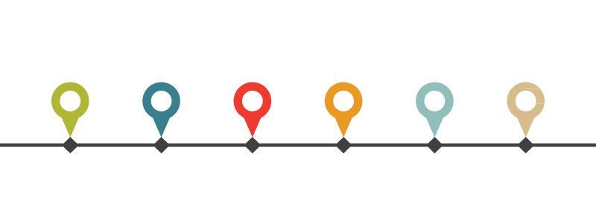
Background and Overview
Purpose/Goal
Interview Guide and Question Development
Timeline
Recruitment
Interview Participation
Post Interview
Notes:
Intent:
Purpose of conducting interviews - a snapshot of team based care across the state
Developed semi-structured interview guide with primarily open-ended questions
31 questions, potential follow-up questions, probing questions encouraged
Primary questions/topics: high-level overview of the health system and interviewee’s role, team-based care in general, and health system-specific team-based care implementation
Captured: How, why, and to what extent are health systems implementing/practicing team-based care which as well as any factors, challenges, or benefits associated
Timeline
End of March into April: developed and finalized semi-structured interview guide with complimentary handouts/worksheets for interviewee’s refernece
Early May: Piloted
May and June: Recruited and conducted interviews
Recruitment method and health system selection/identification as well as targeted role of interviewee (WHCQ – Wisconsin Collaborative for Healthcare Quality)
Interview participation
Interviewed 8 health systems
Interview format/mode: in-person, audio recorded, notes taken.
Average length of interviews
Notes/method during interview
Post interview
Interview notes thoroughness/completion, compiled summary, etc.
Interviews used grounded approach coding

Slide 4
Team-Based Care Definition Provided
“The provision of health services to individuals, families, and/or their communities by at least two health providers who work collaboratively with patients and their caregivers - to the extent preferred by each patient - to accomplish shared goals within and across settings to achieve coordinated, high-quality care.”
Mitchell et al. 2012. Core principles & values of effective team-based health care*
Notes:
Intent:
Explain that we provided this TBC definition to the interviewees
At this time maybe note that it was good we did because no one had a true definition when asked?????
“Differenent individuals are going to interpret what they mean by team based care differently – so responses may vary… Some many think it means working together – others may think it means access for anybody….

Slide 5
Findings
Barriers & Factors
Successes & Benefits
Team Members
Work Flow & Design

Slide 6
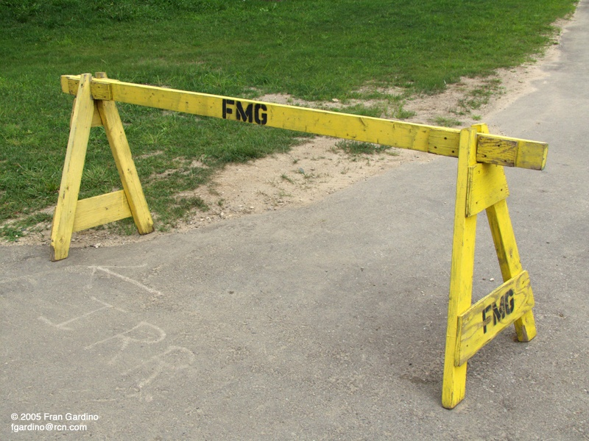
Barriers & Factors
When Implementing Team-Based Care

Slide 7
Barriers & Factors
Lack of Standardization & Evidence-Based Protocols
Uniformity, evidence & definitions: roles, structure, care, work flow, care team
Team Culture & Care Team Relationships
Hierarchical structure, physicians relinquishing work, trust, collaboration, historically siloed*, different training and education, mutual respect, entire team engagement
Staff Capacity
Quantity, skills/knowledge, roles/positions (i.e., nurses, MAs) , lack of training in LEAN processes and flow
Demonstrating Value
Payors, providers, parent organization, all clinical and non-clinical staff
Notes:
*Silos of care do nothing but perpetuate error - have to have team-based care - just can't have one MD provider providing care, one nurse providing care, one pharmacist in his pharmacy providing care, it has to be a collaborative approach - People on the care team feel like partners in care and not subservient
Together, we provide better care for patients with all the minds and all the wisdom together versus one
Intent:
Explain the barriers and factors that came out of the interviews
Black/bulleted: themes
Blue/smaller text: examples of what the themes are comprised of

Slide 8
Barriers & Factors (continued)
Buy-in
Stakeholders, leaders, providers*, administrator*, clinical and non-clinical staff, patients*, everyone, nurses, “top down”
Investment/Financial
Monetary adoption and maintenance support
Payment Structure/Reimbursement
Fee for service, “paid for episodes of care and not longitudinal well coordinated care delivery”, prior authorization*
Notes:
*If it’s not broke, don’t fix it - - - Team based care? We already do that…. We’ve always done that
*Patients: Some patients don’t want to see anyone else (or another person after their visit) on a team – want their provider to just take care of everything in one visit (might be about the money and it might be about the time) – **For some patients, barrier is THEIR time & travel & need for prior auth (diabetes management) (SAUK-JoEllen)
“paid for episodes of care and not longitudinal well coordinated care delivery” (MB&A Aurora)
*THEDA CARE – Scott Have to have a MODEL that rewards the team, too - so that we align incentives to reward the team and not just one provider. Theta has a model where if everything is aligned and quality, cost, satisfaction are all met, the entire team is reported. Financially. Everybody buys into it then.
Explain the barriers and factors that came out of the interviews
Black/bulleted: themes
Blue/smaller text: examples of what the themes are comprised of

Slide 9
Barriers & Factors (continued)
Organizational Structure
Number of patients per physician expectation, processes, Accountable Care Organization
Resources
Training capacity, EHR/EMR access and availability, hiring resources
Communication
Mode, frequency, inclusivity/exclusivity, transparency *
Physical Layout/Environment
Proximity to other team members*, shared working space, access to computers, area dedicated for communication
Other
Patients • Goal Setting • Metrics
Notes:
*People are social creature and we need to give them chances to talk to each other –
* And being in closer proximity increases communication – HB (Gundersen): Co- location of team members - having the RN/provider/MA in close proximity.
Intent:
Explain the barriers and factors that came out of the interviews
Black/bulleted: themes
Blue/smaller text: examples of what the themes are comprised of
Other – some mention but not frequently enough

Slide 10
Implementing Team-Based Care
Successes & Benefits

Slide 11
Successes & Benefits
Staff/Team Satisfaction
Increased clinical and non-clinical staff satisfaction, collaboration *, improved relationships, “wouldn’t work in another place that doesn’t have team”
Patient Outcomes/Quality Metrics
Improved patient health outcomes, transparency understood by entire team*, increased # of patients seen by physician (30%)
Patient Care/Satisfaction/Access
Decreased wait time, “one stop shop”, increased level of respect and trust from patient*
Communication
Improved communication with health care team and patient & amongst health care team members
Notes:
*People working and taking care of patients in a team - have a sustainable work life and not having to be atlas with all the world on their back. “It’s more FUN! Happier clinicians! (SCOTT)
*HB: RN satisfaction, provider satisfaction, physician satisfaction, improvement in disease management scores, improved patient outcomes, improved accomplishment of needed testing.
RB: In their pilot of team care, physician production went up 30%.
RB: Patient buy-in, better services with decreased wait time.
RB: Patient satisfaction scores didn't necessarily go up, but didn't go down. Anecdotally, patients were impressed with coordination of care, continuity of care, decreased wait times, thoroughness of care, one-on-one with RN AND provider.
HB: "A different layer of respect from the patient, and an increased level of trust."
HB.: Patients were impressed with how quickly the coordination of care was done, how seamless it was, and their expectation of step by step care was met. (GUNDERSEN)
*Sharing metrics making sure people can see the shared goals AND the results – specific to their TEAM clinic!
FROEDERT:::::: HOW DO YOU DRIVE CHANGE?
GIVE them the data….
Ask the questions… what happened? What are reasons?
Data, metrics, is BEST PRACTICE
This report goes all the way down to each person and see how well they are doing
So leaders can improve trends by looking at data (not too much data)
WORK Flow chart for standard rooming is developed - patient care operations (AND they will connect each step of the flow chart with the training behind it)
***RN care coordinator:
RN care coordinator supports patient self-management - patient gets connected with RN care coordinator, usually at provider visit, and if not at the time, RN care coordinator will call patient, mutually decide how often to contact, by phone or individualized, or face to face. At this time is free. A bonus to patients as they can come in and see the RN. Very individualized. Using motivational interviewing. Follow-up based on mutually agreed upon goals. Care coordinators can put (assign) themselves on the patient's care team (in the medical record) - so they can pull this information up regularly-run a report to see who they have to contact each day. Taken care of holistically - RN will also take every phone call from THIS patient - even if a refill or a question about… so the RN Care Coordinator can then follow=up on any goals or plans or how things are going.
Patient feedback: provider indicates a condition and opportunity to improve it (diabetes or HTN) - sometimes scary for the patient. Whoa, this is serious, must be real - I'm kind of scared and then they walk out the door and out of sight, out of mind,…. Can put things off. IF the Care Coordinator calls them, they can touch base and ask if they've scheduled the CDE visit or started on the changes or done the next step - and helps patient as a go-between - to facilitate next steps. Hopefully don't fall off the radar, and don't make it back in The PATIENT REGISTRY is really effective - has evolved from a paper XL spreadsheet (provided once a month) that the RN had to review, to Registry that is in the computer - now is timely, reflects guidelines changes, RN can tell what labs are due etc. Now this is a living document that regularly updated.
Providers also have (in Health Link) a dashboard that they can see how they are doing on all patients with A1c's, labs due, follow-up needed, immunizations due,
Patient feedback: Really positive that they have a Care coordinator - someone that they can address questions to - they don't necessarily have to take questions to the provider
Intent:
Explain the successes and benefits that came out of the interviews
Black/bulleted: themes
Blue/smaller text: examples of what the themes are comprised of

Slide 12
Successes & Benefits (continued)
Screenings/Lab
More comprehensive and timely tests accomplished, increased number of preventative tests*
Top-of-License Practice
Further education & training provided, additional or advanced credentialing achieved (“Growing” the staff), RN working w/more complex needs in self management (DM & HTN)*
Interprofessional Collaboration
Workgroups, interaction, and communication established or enhanced among multidisciplinary health professionals
Other
Standardization of Care • Bridge Behavioral Health • Depth of Roles • Patient-Centered Medical Home Certification/Recognition
Notes:
RN CARE Coordinator – UW
Froedert: On insulin? A1c higher than goal? referral to pharmacy for insulin titration and adjustments
Refer to care manager (CDE)
IDEA - high level vision - could we have NP provide hospitalist services? (Laura – Ascension)
Intent:
Explain the successes and benefits that came out of the interviews
Black/bulleted: themes
Blue/smaller text: examples of what the themes are comprised of
Other – some mention but not frequently enough

Slide 13
Successes & Benefits (continued)
EMR/EHR/HIT Advancements *
Best practice alerts*
My Chart advancements*
New ways to use patient portal (DM data entry-BG results) – clinical alerts to patient (“would you please document my foot exam?”)
Registry: New HTN patients (a negative-positive?)*
Clean the data regularly*
Protocols*
Standardized rooming processes
Notes:
*Best practice alerts built into the EMR (Andy/Mary Beth – Aurora)
*“Tools are amazing and we can’t do it without the tools”*****
*Changing My chart access – from being available unfiltered only to the provider – to now available to the care team – some of the volume of questions can be addressed by CMA, RNs… CUT DOWN the volume by 50% to the provider and SUCCESS _ Now My chart inquiries are addressed within 24 hours
REGISTRY: A patient may have had normal blood pressure but hasn’t been in for 3-5 years. Now, with registry, staff are recognizing patients havemnt’ been in, getting them in and then potentially identifying HTN because things have changed in several years. This can be deceiving, because now it looks like numbers are worse because there’s new HTN. It’s actually better because we’re identifying those people. (UW-Jill and Shelley)
CLEAN the data! (Theda Care Scott) – numbers down – no longer patients!
**Physician enters diagnosis of diabetes, EMR cues up diabetes education for 3 visits automatically. (Sauk-Ellen)
Intent:
Explain the successes and benefits that came out of the interviews
Black/bulleted: themes
Blue/smaller text: examples of what the themes are comprised of
Other – some mention but not frequently enough

Slide 15
Advice
For Implementing Team-Based Care

Slide 16
Communicate effectively
process, goals, strategies, best practices
Strategically plan & gain knowledge
talk with others, pilot test or start at small scale,/start slowly, develop team-based care definition beforehand, define goal or purpose as well as metrics and success
Establish workgroup or committee
frontline, steering committee, advisory board, formal and informal leaders
Engage and seek input from everyone
leadership, financing, providers, patients, all health care professionals and team members
Get buy-in from everyone
leadership, financing, providers, patients, all health care professionals and team members
Establish two-way communication
open to feedback, understand what’s working well, lessons learned
Educate & inform
team-based care concept, update changes, highlight success at any scale, provide strategic plan, setup training schedule
Notes:
SHARE WINS!!!! Quickly and often – Paint a picture about what team based care looks like… USE STORIES!!!! (MB&A: Aurora)
Theda CARE Scott TEAM members are "scripted" to talk about preventive measures importance - "Scripted" to talk about what things are important and what the A1C lower means - that way we are all saying the same thing AND patients are impressed that Scott's MA says A1C is important and going to be done, then he comes in the room and says it's important! CANDOR with respect – THANK THE MA (rn, lab) in front of the patient….
Value employees. They are the greatest asset – think about physicians now as “precious resource” (support)
RECIPE FOR QUALITY: engage patient + engage caregivers = High quality outcomes
(MB-A=Aurora)
Intent:
Explain the advice health systems gave during the interviews
Note that most health systems seemed to answer for starting up/initial stages of implementing TBC
Bolded: more general themes/overall message
Non-bolded/smaller text: examples of what the themes are comprised of

Slide 17
Team Members
Engaged in Team-Based Care

Slide 18
Team Members
Least
Some
Most
All
Community Health Worker
Dental Hygienist or Other Dental Role
Dentist
Emergency Medical Professional/ Technician or Paramedic
Home Health Aide
Nursing Assistant
Patient Navigator
Appointment Specialist
Behavioral Health Specialist
Case Manager
Health Coach or Educator
Medical or Clinical Lab Tech
Medical Records/HIT Tech or Informaticist
Medical Specialist
Nurse Leader
Receptionist
Therapies
Administrative Leader
Administrative/ Support Staff
Care Coordinator
Certified Diabetes Educator
Doctor of Osteopathy
Licensed Practical Nurse
Medical Assistant
Nurse Practitioner
Pharmacy Tech
Registered Dietitian or Nutritionist
Registered Nurse
Pharmacist
Physician
Physician Assistant
Social Worker
Notes:
Intent
Varied by health system – range of 9-33 team members identified as being part of the team
Provided handout/list of team members to reference with ability to add additional members
Least, Some, Most, All are a range/the extent health systems identified the roles as being part of the “team”
Specifically/FYI:
Least meaning limited number of health systems identified role as being part of the team or 1-2 health systems
Some = 3-4 health systems
Most = 5-7 health systems
All = 8 health systems

Slide 19
Workflow & Design
To Support Team-Based Care
Implementation
---
What is the current model?
Notes:
*NEED to have a model that rewards the team…. And not just one provider

Slide 20
Workflow & Design
Workgroups
Interprofessional groups or committees with a focus
Hypertension population focus workgroup made-up of clinical staff, MD, pharmacist, analytics, and EMR designers
High-risk patient focus led by care coordinators and made-up of RNs, pharmacists, and social workers
Protocols and Standards of Care
Evidence-based guidelines - CDE *
Hypertension readings, new diabetes diagnosis, referral to behavioral health
Anticoagulation & refill protocols run by nurses/pharmacists (with oversight)
Support Tools and EMR/EHR/HIT
Smart Set, registry, telehealth, digiceuticals, Health link
Evidence based algorithm built into charts
Notes:
CDE – documented to get a 1.5% reduction in A1c without addition of medication, just from the education and counseling/coaching
Intent
Explain the work flow/how health systems designed team-based care
Note no standard/consistency among health system in the details, but overall design/work flow was derived; such as protocols/standard of care for patients with a first blood pressure reading higher than 140/90 – one health system has a protocol for the RN to take the second blood measurement whereas another health system’s protocol has the same, initial MA responsible for taking the second blood pressure measurement
Black/bulleted: common design/workflow
Blue/smaller text: examples of the common design/workflow described in interviews

Slide 21
Workflow & Design (continued)
Role Responsibilities and Top-of-License Practice*
Pharmacy leads/handles all hyperlipidemic, angiotensin receptor blockers, anticoagulation medications – or insulin titration (management)
RN triage and teaching – RN with Medicare Annual Wellness visits
MA completes template according to chronic condition
Team Composition and dynamics
Psychologist available on site (goal for many). 1 MD : 1 MA, passers/schedulers for all care teams, 2 MD : 1 RN, shared external care coordinators
Two way communication – team takes input from all sides
Pre-visit Planning
Chart review, contacting patient a day before appointment, review for gaps in care, arrange for lab tests, have pending orders prepared/ready for provider in patient record
Notes:
*What's the best use for my physician provider
What's the best use of my RN provider
What's the best use of my APP provider
What's the best use of my MA provider
What's the best use of my dietitian provider
what's the best use of my pharmacist provider
THEN - using them to the top of their licensure, and
Using them to the top of their talents - the things that they love
Intent
Explain the work flow/how health systems designed team-based care
Note no standard/consistency among health system in the details, but overall design/work flow was derived; such as protocols/standard of care for patients with a first blood pressure reading higher than 140/90 – one health system has a protocol for the RN to take the second blood measurement whereas another health system’s protocol has the same, initial MA responsible for taking the second blood pressure measurement
Black/bulleted: common design/workflow
Blue/smaller text: examples of the common design/workflow described in interviews

Slide 22
Workflow & Design (continued)
Huddles (sometimes with Huddle sheet – Huddle board)
Daily, beginning of each shift, as issues arise*
Everyone, only clinical staff, entire team besides physicians
Chronic Disease Huddle (Team, provider, RN, Pharmacy) – meets monthly
Patient
Engage patient and family, collect patient satisfaction
Patient Goals *
Transparency
Metrics, shared goals, patient outcomes, celebrate successes, “scripted” talk about importance of controlled HTN/A1c lowering
Notes:
All sites have daily huddle – in one of the clinics, “they ring a bell and everyone comes running”
*Mary Beth Kingston and Andy (AURORA)
PATIENT GOALS: Harder to find (all systems) – “What is really a patient goal? Is an A1c range a pt goal or a medical goal. In the LIFESTYLE PILOT they have participants write their own epitath – THAT really helps them Identify their goals”
*JoEllen: Our policy is that everyone who walks out the door has a diabetes self management plan in their hand. The patient doesn’t leave the exam room without a followup card and a plan.
Intent
Explain the work flow/how health systems designed team-based care
Note no standard/consistency among health system in the details, but overall design/work flow was derived; such as protocols/standard of care for patients with a first blood pressure reading higher than 140/90 – one health system has a protocol for the RN to take the second blood measurement whereas another health system’s protocol has the same, initial MA responsible for taking the second blood pressure measurement
Black/bulleted: common design/workflow
Blue/smaller text: examples of the common design/workflow described in interviews
Intent
Explain the work flow/how health systems designed team-based care
Note no standard/consistency among health system in the details, but overall design/work flow was derived; such as protocols/standard of care for patients with a first blood pressure reading higher than 140/90 – one health system has a protocol for the RN to take the second blood measurement whereas another health system’s protocol has the same, initial MA responsible for taking the second blood pressure measurement
Black/bulleted: common design/workflow
Blue/smaller text: examples of the common design/workflow described in interviews

Slide 23
Next Steps
For Implementing Team-Based Care

Slide 24
Next Steps
Utilize interview findings
Continue conversation
Stay engaged and keep informed
Reference patient-centered team-based care model
Notes:
Noting the findings very much coincide with PCTBC model
Have them think about how they will integrate all of this into their work/health system ???
Patients will continue to outnumber physicians and providers - and that discrepancy is going to grow - so patients will less and less able to rely on a single provider to be their sole source of provision of care (Kastman-GHC)

Slide 25
Discussion
&
Questions

Slide 26
Frosting…
“Believe in the unimaginable!” We did it!
TEAMSTEPPS – effective team building
Intermountain Healthcare - Behavioral Health Model (UTAH)
Grocery walk-through with dietitian
MA Academy (information, education, speakers, updates, burnout, vaccines, depression). RN Academy is next.
“Extraordinary health care – one patient at time.”
“Treat employees as your most valuable asset and as precious commodities.”

Slide 27
THANK YOU! To Interview Participants
Andy Anderson, MD, MBA – Chief Medical Officer - System and Executive Vice President
Holly Boisen, RN - QI Project Manager
Robyn Borge, MD - Department of Family Medicine, Director of Patient Care Innovations
JoEllen Frawley, APNP, CDE
Chris Kastman, MD - Medical Director for Population Health at GHC
Mary Kerrigan, BSN, RN - Regional Director of Operations
Shelley Key RN, BSN - Clinical Staff Educator
Mary Beth Kingston, RN, MSN, NEA-BC, Executive Vice-President & Chief Nursing Officer
Jill Lindwall MSN, RN - Ambulatory Care Coordination Program Manager
Laura Magstadt MBA, MSN, RN, NE-BC - Regional Vice President Operations
Scott Schuldes APNP - Associate Medical Director
Ellen Wermuth MD – Family Practice

