Slide 1
Applications to Practice © Wisconsin Organization of Nurse Executives
Wisconsin Nurse Leadership Academy

Slide 2
Academy Applications to Practice
Objectives:
Integrate knowledge and skills from previous day and half into practice
Discuss mentor qualities and selection process
Share expectations of project and presentation on Day 3

Slide 4
Leadership Development
Identify your strengths/areas for growth include your self renewal goal.
Journal in document, “Leadership Assignment Part I”.

Slide 5
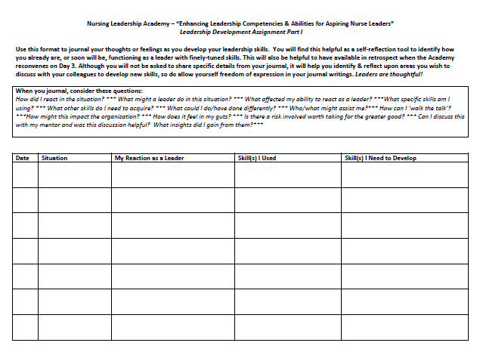

Slide 6
Mentor Role
A Mentor is…
… someone who makes a difference in another person’s life.
… one of Coach, Guide, Motivator, Advisor, and Role Model
A mentor-mentee partnership is…. built upon trust, respect, and professionalism.

Slide 7
Mentor Responsibilities
Coach and guide Mentee toward achieving a specific developmental goal.
Set realistic expectations regarding method and frequency of communication
Actively listen to the Mentee.
Provide the Mentee with information about opportunities he/she should explore.
Give constructive feedback.

Slide 8
Mentee Role
A Mentee is...
…. motivated to assume responsibility for her/his own professional and personal growth and development.
A Mentee will…
…. Initiate contact and set up meetings
…. Review your development plan with your Mentor and work towards achieving the stated goals.
.... Accept constructive feedback

Slide 9
“Personal leadership is not a singular experience. It is, rather, the ongoing process of keeping your vision and values before you and aligning your life to be congruent with those most important things.”
Stephen Covey

Slide 10
Project Expectations
Discuss in your small group ideas for your project.
Choose something you are passionate about
Use the principles you have learned over the past few days
Change, conflict mediation, communication etc.
Discuss with person who sent you the value of the project to your organization
Present in small group on 3rd day

Slide 11
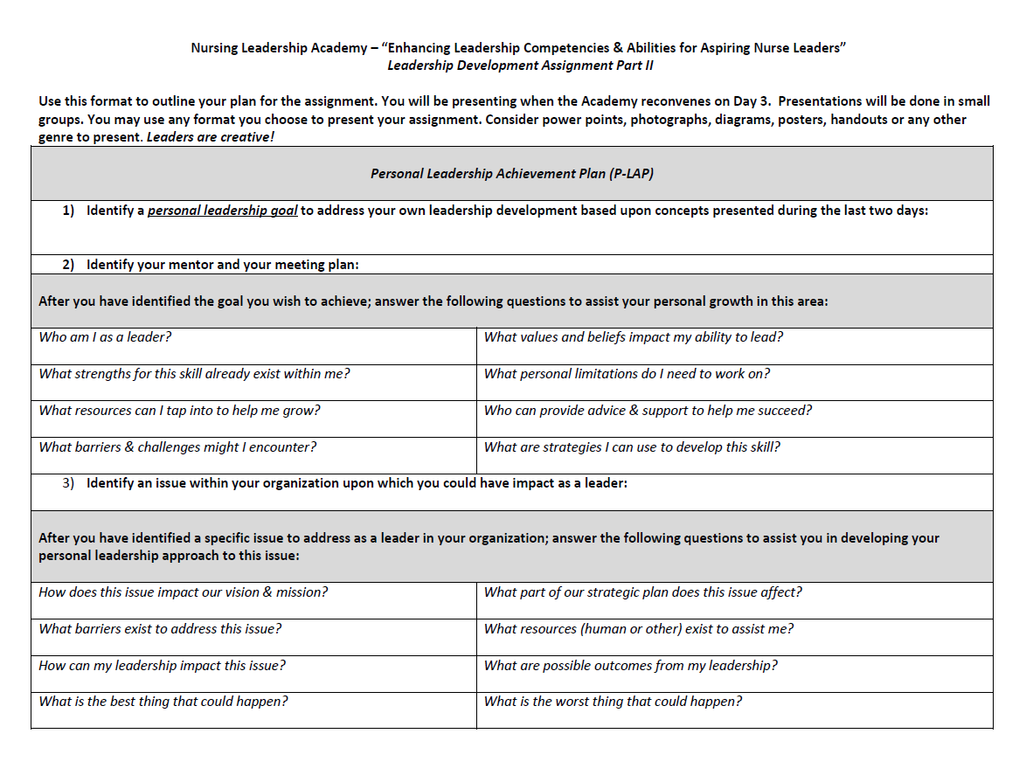

Slide 12
Examples of Previous Projects

Slide 13
Examples of Previous Projects

Slide 14
Examples of Previous Projects

Slide 15
Examples of Previous Projects

Slide 16
Examples of Previous Projects

Slide 17
Examples of Previous Projects

Slide 18
Any questions?
Be sure to turn in completed Participant Evaluations for Days 1 & 2 before leaving!

